Slide 1
Python Course for Physicists – Chunk 1: Introduction
By Jonathan Bollig
08.10.2025

Slide 2

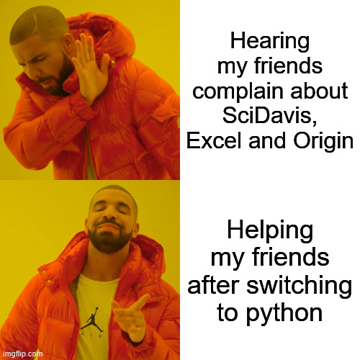
Background & About Me
jonathan.bollig@uni-jena.de
Master: Physics & Photonics
Bachelor: Physics in Jena
Self-taught Python with YouTube before studying
→Super useful in physics
Tried to convince all my friends
Now a course for everyone else
→ First time :)

Slide 3
The Tutors

Slide 4
About You
Umfrage (per Meldungen oder irgendeiner Webapp + Abstimmungsapp)
Studium
Vorerfahrung

Slide 5
General Information – Times and Dates
Dates:
Regular: Wednesday to Friday
Maybe Saturday if delayed or for extra “chunks” (Improvised if demanded)
Times:
Start at 09:30
Lunchbreak 12:30 – 13:30
Finish: ~16:30
Lecturing type:
15-minute lectures (Chunks) with 45-minute practice sessions
3 chunks before and 3 after lunch → 18 chunks in total

Slide 6
General Information – Lecturing Type
15 Minute Lectures: Concise introductions to topics
YouTube tutorial style
PDFs are uploaded
45 Minute self practice:
Usage of Jupyter Notebooks: Tasks and solutions in one place.
Cheat sheet included at the top
Easy, medium and advanced tasks
Generally:
Come and Go whenever you like
Ask Questions directly
Notes:
Recommend: Follow along

Slide 7
Why Coding?
Data Analysis
Simulations

Slide 8
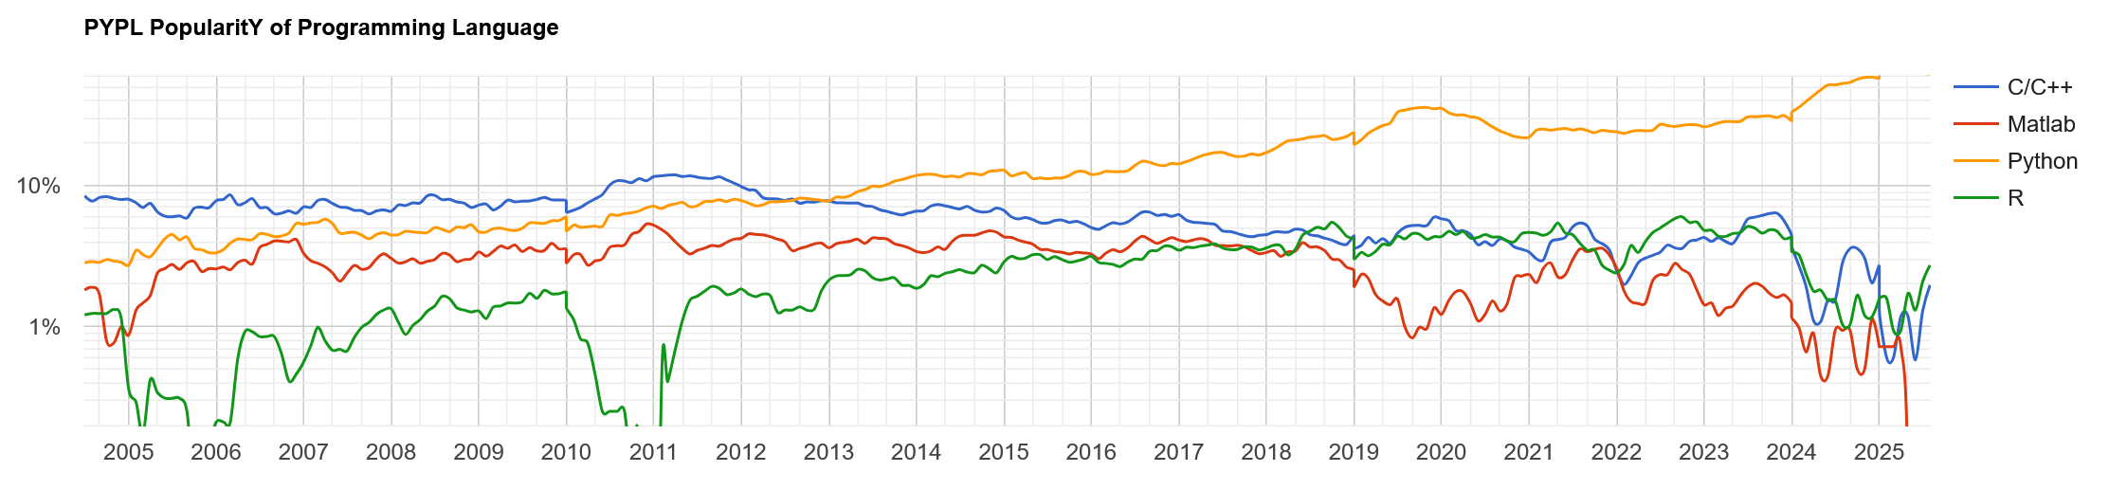
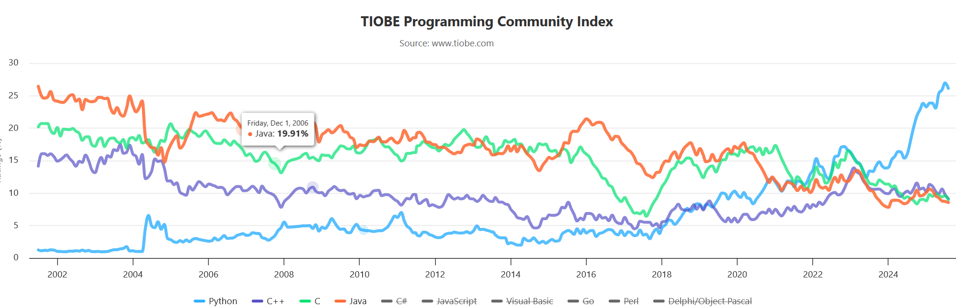
Why Python?
[https://pypl.github.io/PYPL.html]
Most popular programming language world-wide
Web Development, AI / LLM, Data Science
Popular in the scientific community (anecdotal evidence)
Used here in Comp. Physics 1 – 4, comp. Photonics
Personally, used it in 5 different research groups
Matlab ⚡Python ⚡C/C++
[https://www.tiobe.com/tiobe-index/]
Notes:
Tiobe Index: Complicated calculation
Pypl Index: Popularity based on web searches (Here Data for Germany)
Anecdote on Python helping me in applications

Slide 9
Comparison to other languages, (dis)advantages of Python
Easy to learn
Readable
Slow but can be fast
Popular

Slide 10
Notes on downloading the stuff from Git
As zip
Or single files

Slide 11
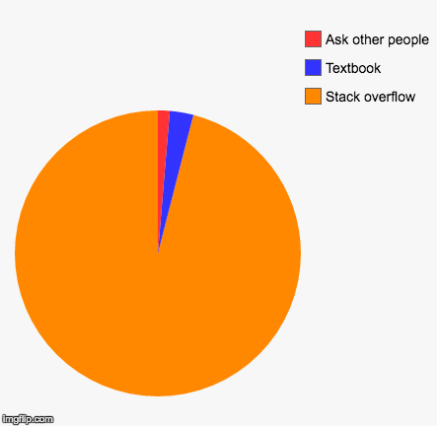
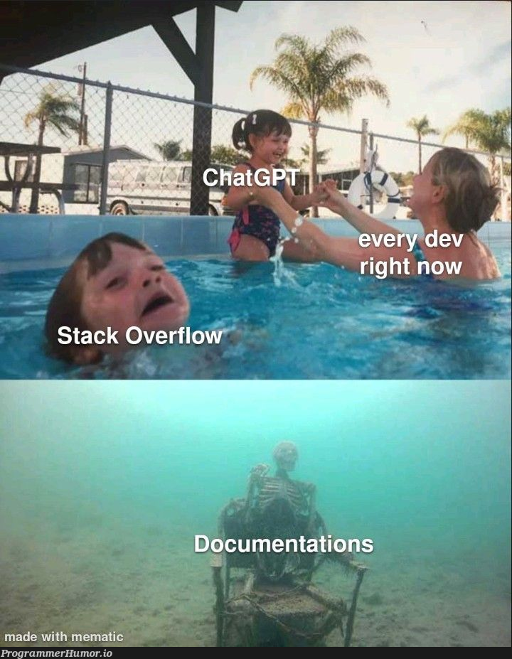
Some notes on solving task sheets
Splitting into second room
If you get stuck:
Try yourself again
Ask your neighbor
Ask google (Stackoverflow <3)
Ask assistants
(Maybe) ask LLM (ChatGPT / Perplexity / Copilot)
Struggling and debugging are 90% of a coders work
[Deleted User on Reddit]
[Programmerhumor.io]

